Slide 1
Human Domination of Earth’s Ecosystems
Vitousek, Mooney, Lubchenco, Melilo (1997). Science 277.
September 5, 2019

Slide 2
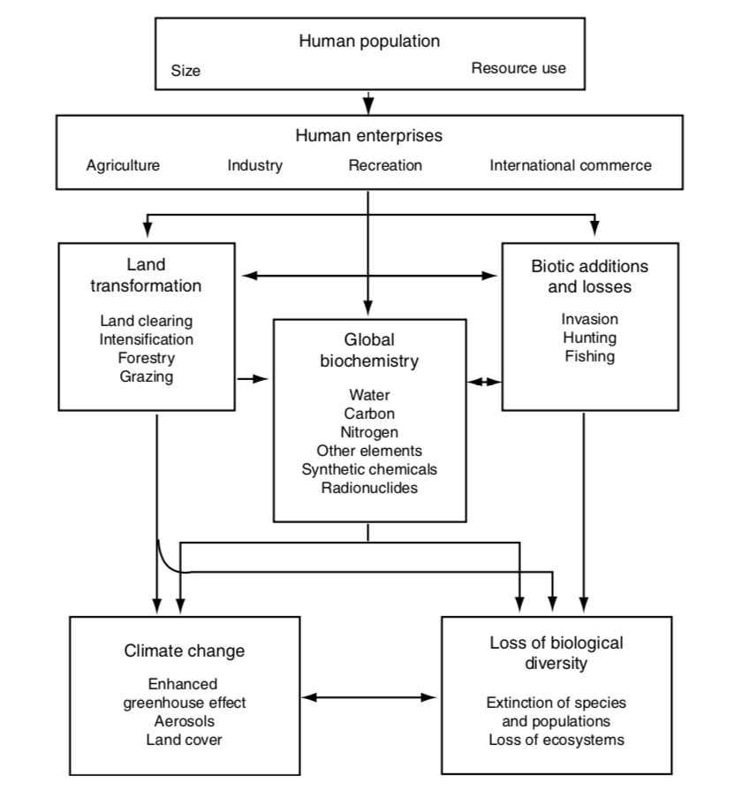
Direct and indirect impacts of humans on Earth’s ecosystems

Slide 3
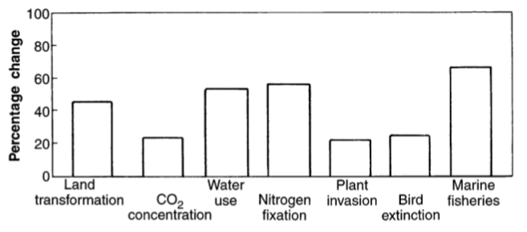
Humans change is not insignificant

Slide 4
Direct and indirect impacts of humans on Earth’s ecosystems

Slide 5
Land transformation
Nearly 50% of all land has been transformed by humans
Primary driver of species loss
20% of all CO2 emissions
Border between Haiti (left) and Dominican Republic (right)

Slide 6
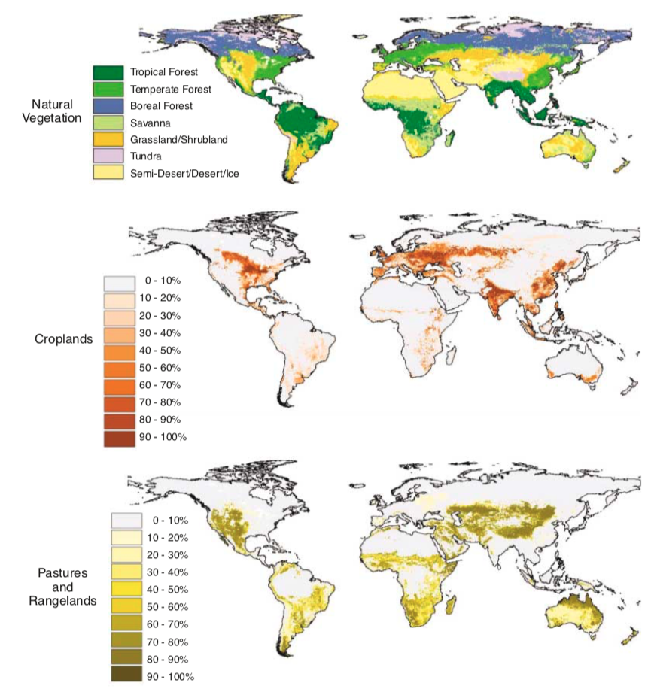
Foley et al. (2005)

Slide 7
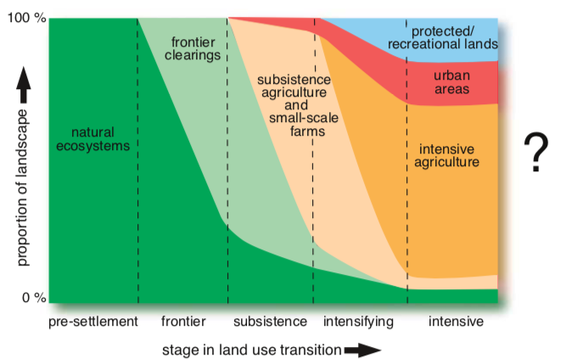
Progressive land transformation (Foley et al. 2005)

Slide 8
Direct and indirect impacts of humans on Earth’s ecosystems

Slide 9
Biogeochemistry - Carbon
Humans emit 5,500,000 tons of C per year
Ecosystems take up only 2,300,000 tons per year
Impacts
Climate change
Ocean acidification
Decreased food quality

Slide 10
Biogeochemistry - Water
Humans use 50% of accessible freshwater
70% of that in agriculture!

Slide 11
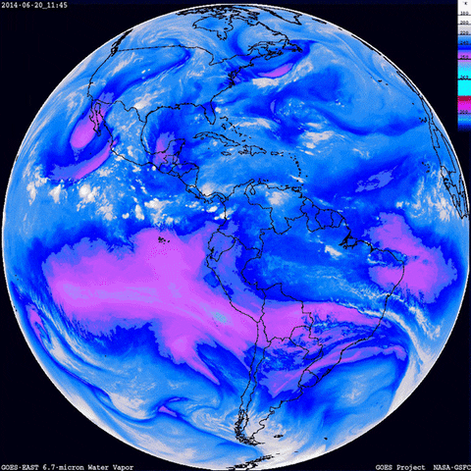
Biogeochemistry - Water
Humans use 50% of accessible freshwater
70% of that in agriculture!
Water travels long distances
Water use can impact climate locally and far away

Slide 12
Biogeochemistry - Nitrogen
Human activities add as much fixed N to terrestrial ecosystems as all natural sources combined!
Where does it come from?
USDA

Slide 13
Biogeochemistry - Nitrogen
Human activities add as much fixed N to terrestrial ecosystems as all natural sources combined!
Where does it come from?
N saturation – not all N can be taken up
Where does it go?
USDA

Slide 14
Direct and indirect impacts of humans on Earth’s ecosystems

Slide 15
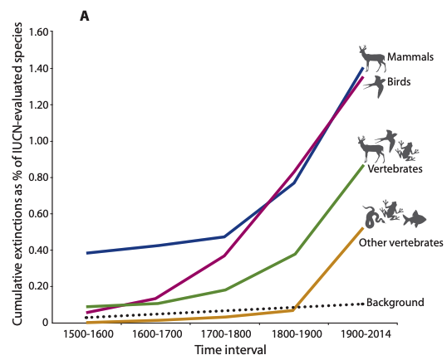
Biotic change – Species loss
Ceballos et al. (2015)

Slide 16
Biotic Changes – Species Loss
Pimm et al. (2014)

Slide 17
Biotic Changes - Invasion
Early et al. (2016)

Slide 18
Biotic Changes - Invasion
Early et al. (2016)

Slide 19
Biotic Changes - Invasion
Early et al. (2016)

Slide 20
Direct and indirect impacts of humans on Earth’s ecosystems
Anything missing??

Slide 21
Some things to chat about

Slide 22
1. Who pays the cost?

Slide 23
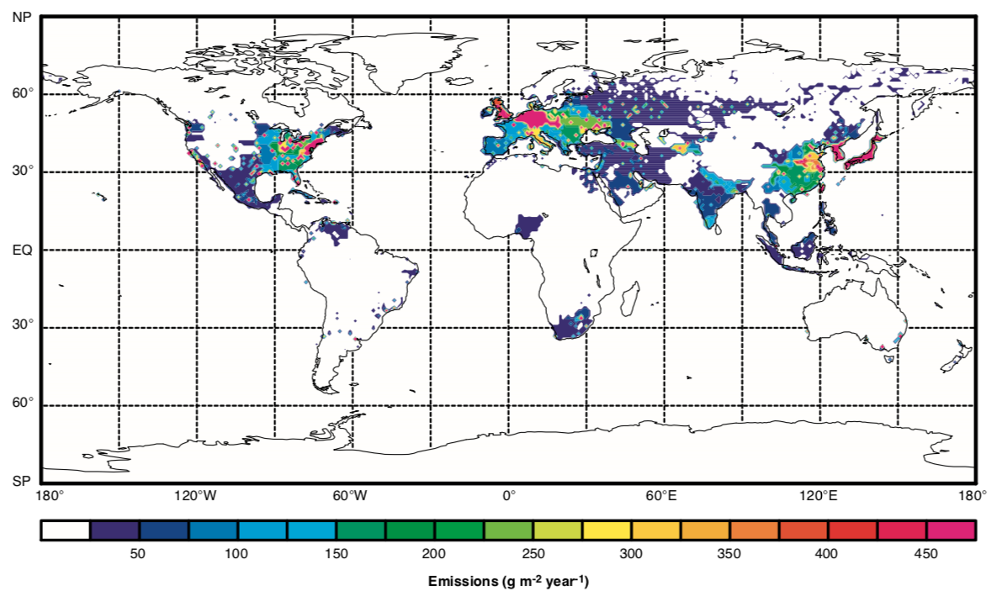
Global CO₂ emissions

Slide 24
Are consequences paid by the perpetrators?

Slide 25
Should/how do we regulate this?

Slide 26
2. What would the world look like without humans?

Slide 27
“There is no clearer illustration of the extent of human dominance of Earth than the fact that maintaining diversity of “wild” species and the functioning of “wild” ecosystems will require increasing human involvement”

